Slide 1
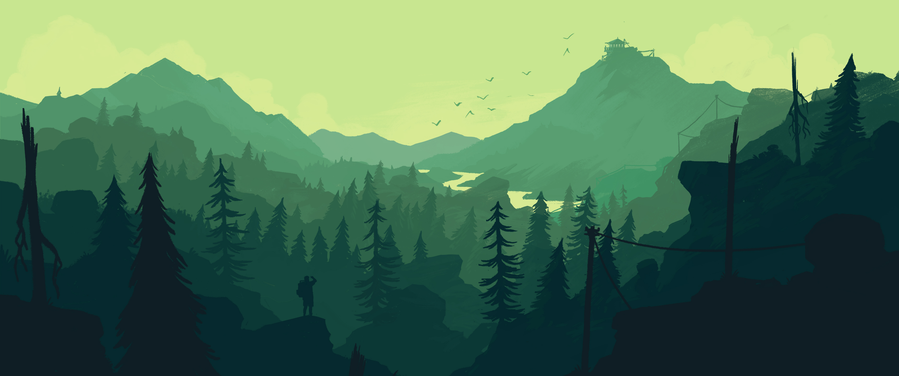


Slide 2



Made by: Bear With Me

Slide 3
Who are we?
First year fontys Ict students

Slide 4
OUR TEAM
Martin S. Hristiyan T. Emil K. Joseph W.
We have no experience in all this whatsoever.
P.S Please don’t sue us for copyrights ☺

Slide 5




WhERE CAN YOU FIND US ?
- Social Media
Our WEBSITE
Email us for more info

Slide 6
What are we going to present today?

Slide 7
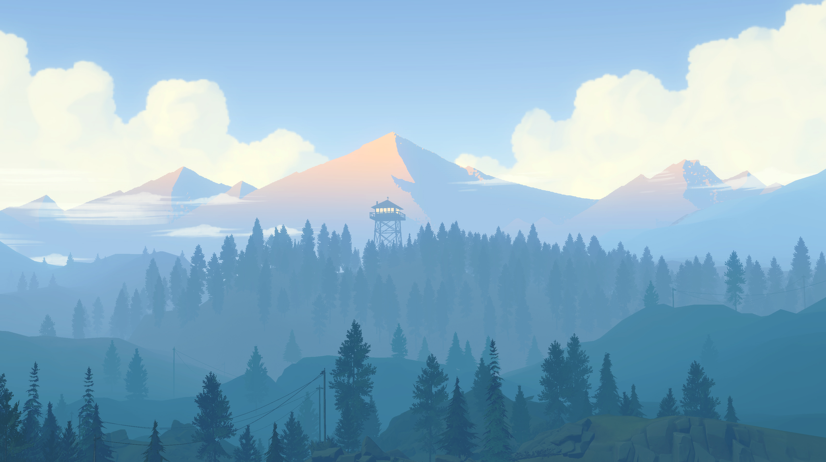

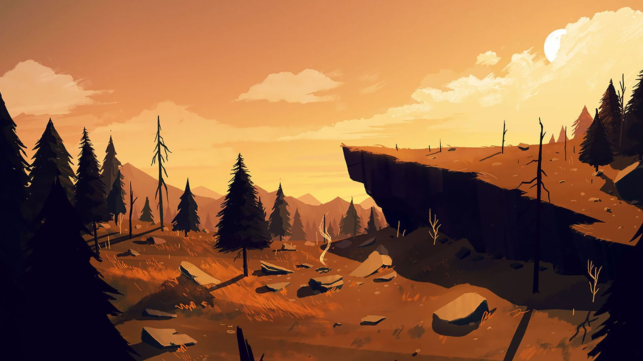
Camping resort ‘oasis’

Slide 8
What oasis has to offer:
- Stunning views
- Good people
- Good times
- Various events
- lots of fun

Slide 9
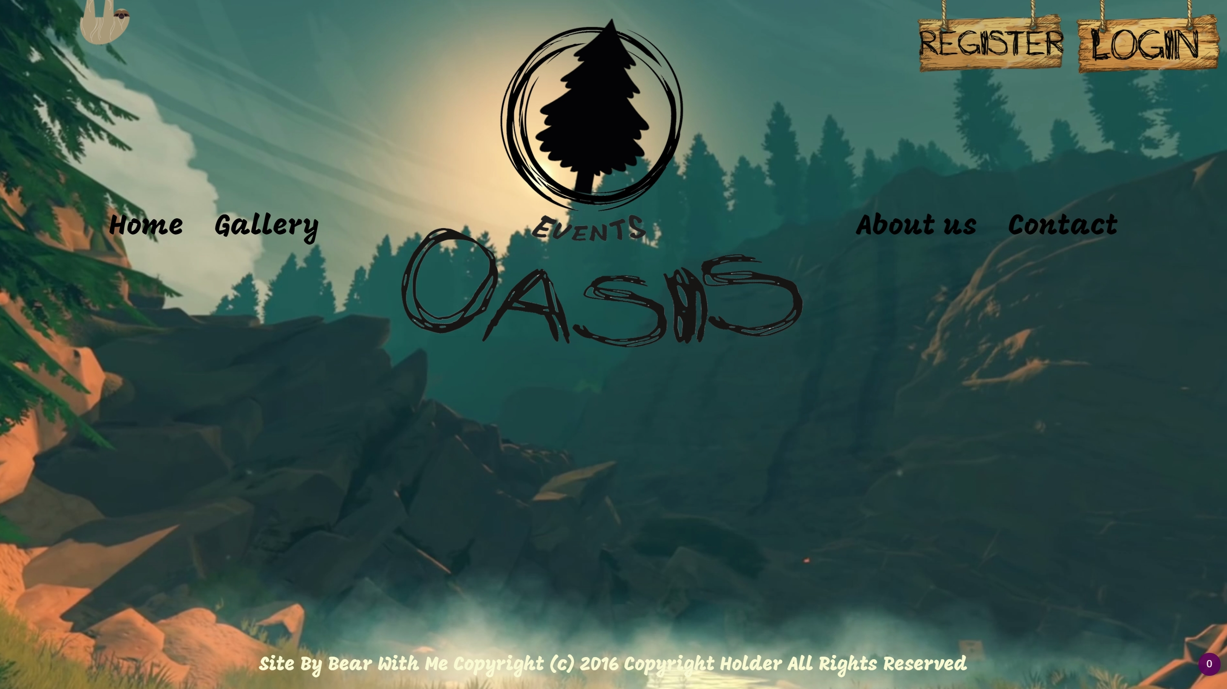
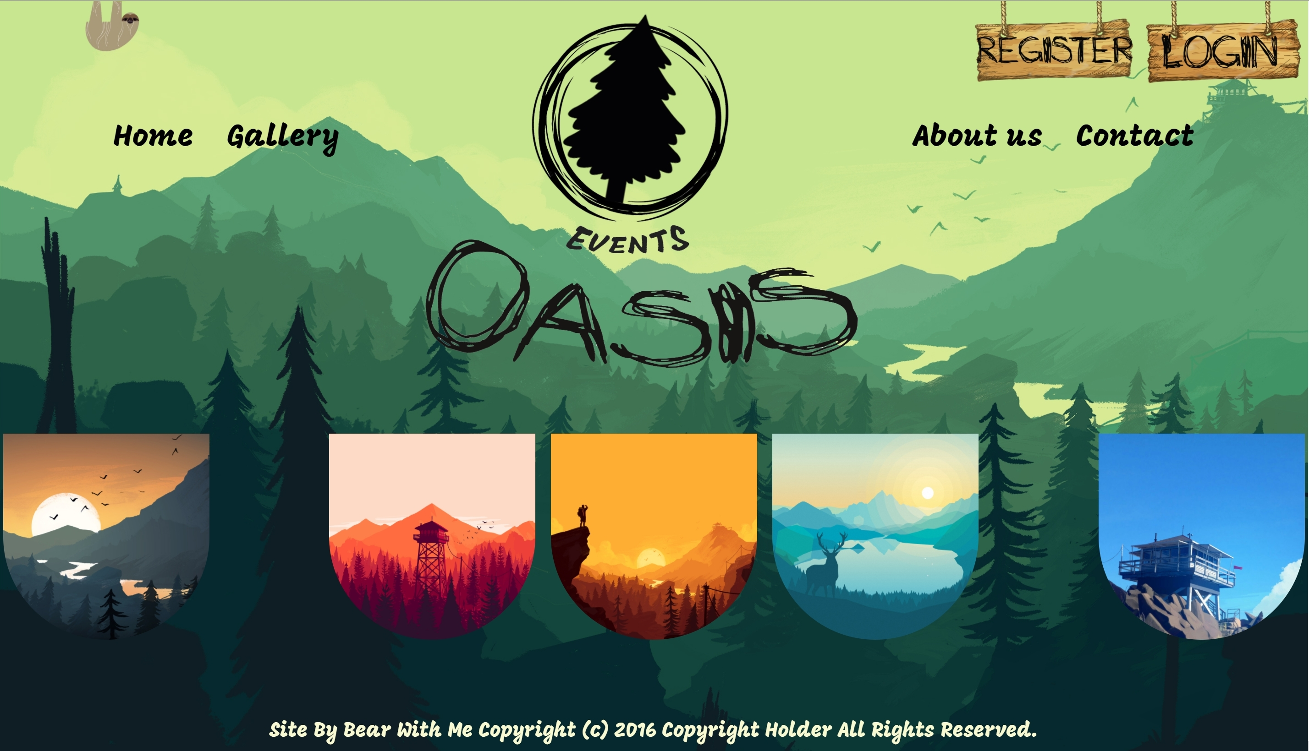
First we will start with the website

Slide 10
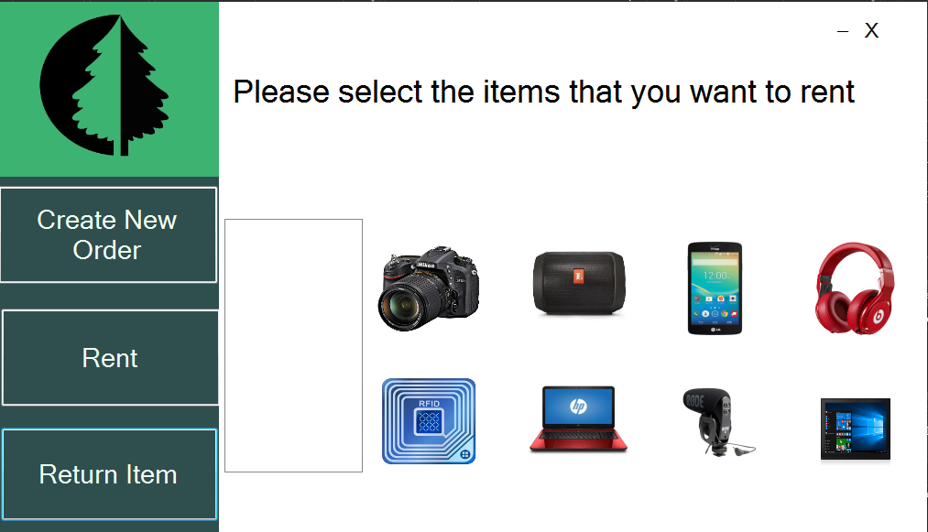
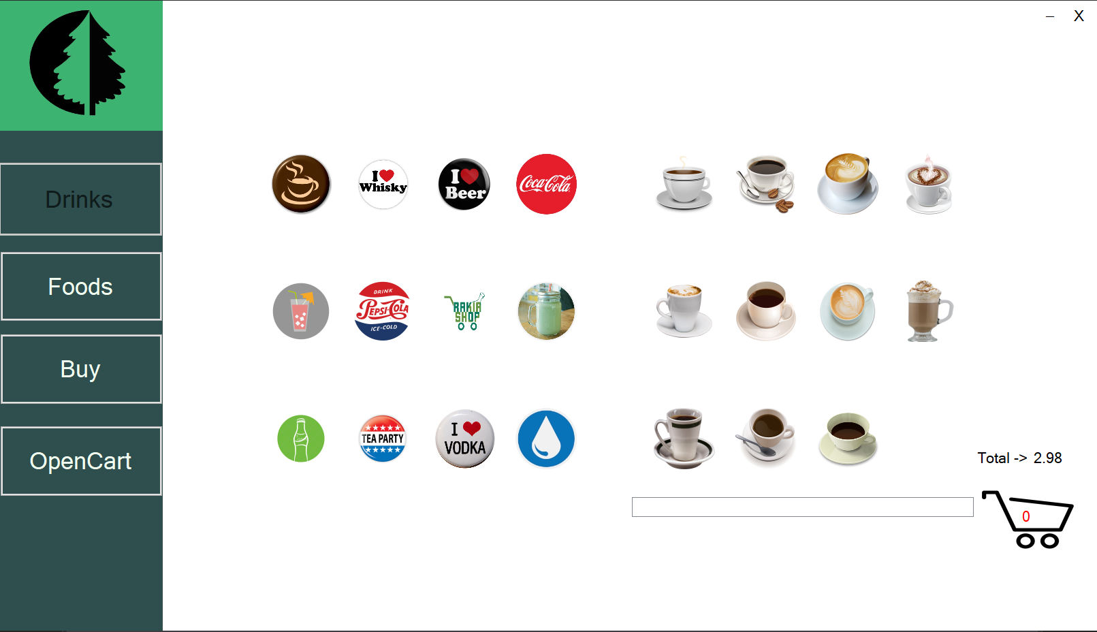
Then demo of the applications

Slide 11
E n j o y

